Slide 1
Unit - II Structured Query Language

Slide 2


Introduction to JDBC
JDBC Architecture
Interfaces and Classes in JDBC API
Steps to Perform JDBC Operation
Example Java Program

Slide 3
JDBC – Need?

Slide 4

JDBC – Need?
While developing an IT application you will come across scenarios
where you will have to store /persist data available in a program (Object states) for a longer duration,
so that data can be retrieved at later point of time if needed for processing.
This is where JDBC comes handy.

Slide 5
What is JDBC

Slide 6
What is JDBC
JDBC is a Java API which enables
Java Programs to connect to Databases, search, modify and delete data.
to store,
JDBC API is an interface based, industry standard for connectivity between Java programs and SQL based Databases.
The JDBC standards are defined using Java Interfaces defined in java.sql package.

Slide 7
What is an API?

Slide 8
What is an API?
Application Program Interface
a set of routines, protocols, applications
and tools for building software

Slide 9
JDBC
A programmer will be able to achieve 3 things using JDBC API.
Establish Connection with Database
Send SQL commands to the Database
Process the results sent by the Database
The latest JDBC version available is JDBC 4.0.

Slide 10
JDBC
Architecture

Slide 11
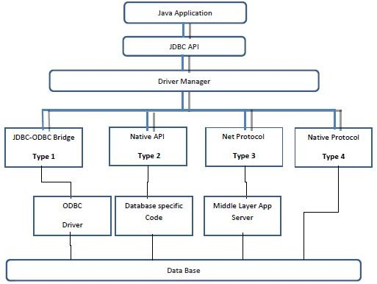

Slide 12
JDBC Architecture - DriverManager
Using JDBC API,
the application developer,
will instruct DriverManager to manage driver classes.
As of now we should only understand that
DriverManager is a java program available in JDBC API which we will use to manage drivers.

Slide 13
JDBC Drivers

Slide 14
JDBC Drivers
JDBC Drivers are programs
which can communicate to the database in the language,
that database understands.
There is lot of database available in the market,
e.g, Oracle, MSSQLServer, MySql, Postgres and DB2 etc.
Each database has own way of interpreting SQL.

Slide 15

JDBC Drivers
Drivers are capable of interpreting the java instruction and converting them to the database specific instructions.
It also helps processing the results given by the database and converts to a format that java application can understand.
There are majorly four types of drivers available.
Database commands
JDBC calls
Driver
Database

Slide 16
Important Interfaces and Classes
in JDBC API

Slide 17
Driver Manager &Connection
Driver Manager
DriverManager is a class which is available in java.sql package.
This class is used to manage set of drivers.
Connection
Connection is an interface
whose implementation object represents a session with the database.

Slide 18
Statement
This interface represents a SQL statement that needs to be executed.
It has many important methods for executing different types of SQL
During execution the Query to be executed at database is compiled first of all to check if the query is syntactically correct.
If it is correct it executes the query to get the result from the database.
In case query is syntactically incorrect the method throws an Exception at Run time.

Slide 19
Result Set
ResultSet interface executing a Query.
represents the results that we get by
The result of executing a query is like a table which can have multiple rows, each row having multiple fields.
A ResultSet object also maintains a cursor pointer which points to current record.
There are methods available in ResultSet to navigate through the multiple rows that we received as result of executing the query.
This interface has lots of methods which can help us retrieve data of a field in a specific format.

Slide 20
Prepared Statement
Interface which stores a SQL statement which is precompiled.
Using this query is not complied every time before execution.

Slide 21
Important Steps to
Perform JDBC Operation

Slide 22




Overview of Querying a Database With JDBC
Connect
Query
Process results
Close

Slide 23





Stage 1: Connect
Connect
Register the driver
Query
Connect to the database
Process results
Close

Slide 24



Stage 2: Query
Connect
Query
Create a statement
Process results
Query the database
Close

Slide 25



Stage 3: Process the Results
Connect
Query
Step through the results
Process results
Assign results to Java variables
Close

Slide 26




Stage 4: Close
Connect
Query
Close the result set
Process results
Close the statement
Close
Close the connection

Slide 27
Steps Involved in Basic JDBC Operations
Driver Manager
1. Load the JDBC driver class:
Class.forName(“driverName”);
Driver
2. Open a database connection:
DriverManager.getConnection (“jdbc:xxx:datasource”);
Connection
Database
3. Issue SQL statements:
stmt = con.createStatement(); stmt.executeQuery (“Select * from myTable”);
Statement
4. Process result set:
while (rs.next()) {
name = rs.getString(“name”); amount = rs.getInt(“amt”); }
Result Set

Slide 28
import java.sql.*; class lib
{
public static void main(String args[])
{
Connection con; Statement stmt; ResultSet rs;
try{ Class.forName("oracle.jdbc.driver.OracleDriver");
con=DriverManager.getConnection("jdbc:oracle:thin:@localhost:1521:xe","system","sastra123"); stmt=con.createStatement();
System.out.println("\n Connection Established \n\n");
String ret="Select * from student"; rs=stmt.executeQuery(ret);

Slide 29
while(rs.next())
{
String a,b; int c;
a=rs.getString(1); b=rs.getString(2); c=rs.getInt(4);
System.out.println(“Regno:--->" + a +"\t"+
"Name:--->" + b + "\t"+“Mark:--->"+c);
System.out.println("\n");
}//while
}//try catch(Exception e)
{
System.out.println(e);
}
}//main
}//class

Slide 30

JDBC
Interfaces and Classes in JDBC API
Steps to Perform JDBC Operation
Example Java Program

Slide 31


